Slide 1
Ignite 2017 recap
Firstname Lastname
Get the latest version of this presentation from
http://bit.ly/Ignite2017Recap

Slide 2



Firstname Lastname Microsoft MVP Title | Company
@Twitter
firstname.lastname@company.com

Slide 3

Ignite 2017
What is it, and why should I care?

Slide 4
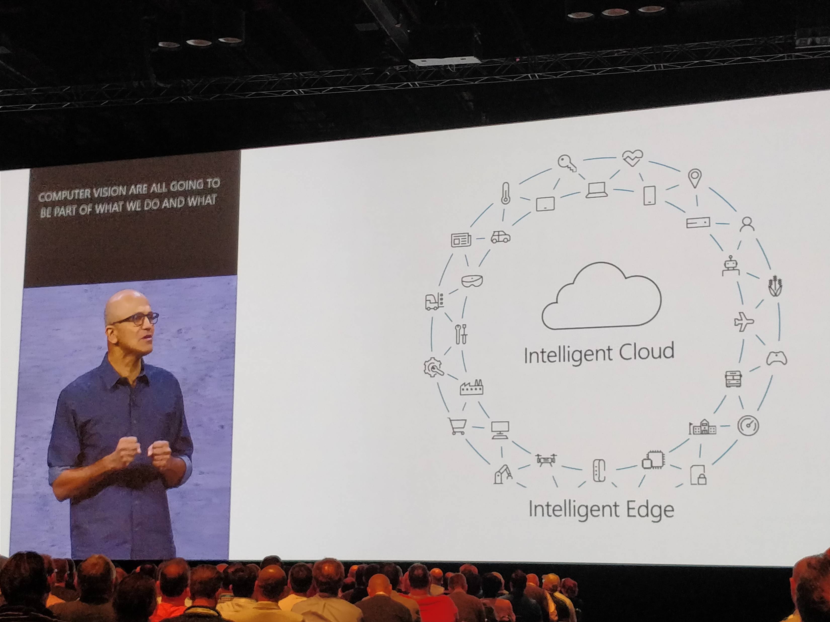
Largest Microsoft event of the year
Held in Orlando in late September
5 days, over 900 sessions representing all major Microsoft products and services
4 keynotes
Main keynote (Satya Nadella)
Modern Workplace (Kirk Koenigsbauer)
Business Applications (James Phillips)
The Enterprise Cloud (Scott Guthrie)
Over 24000 attendees
Session recordings and PowerPoints available through MyIgnite

Slide 5
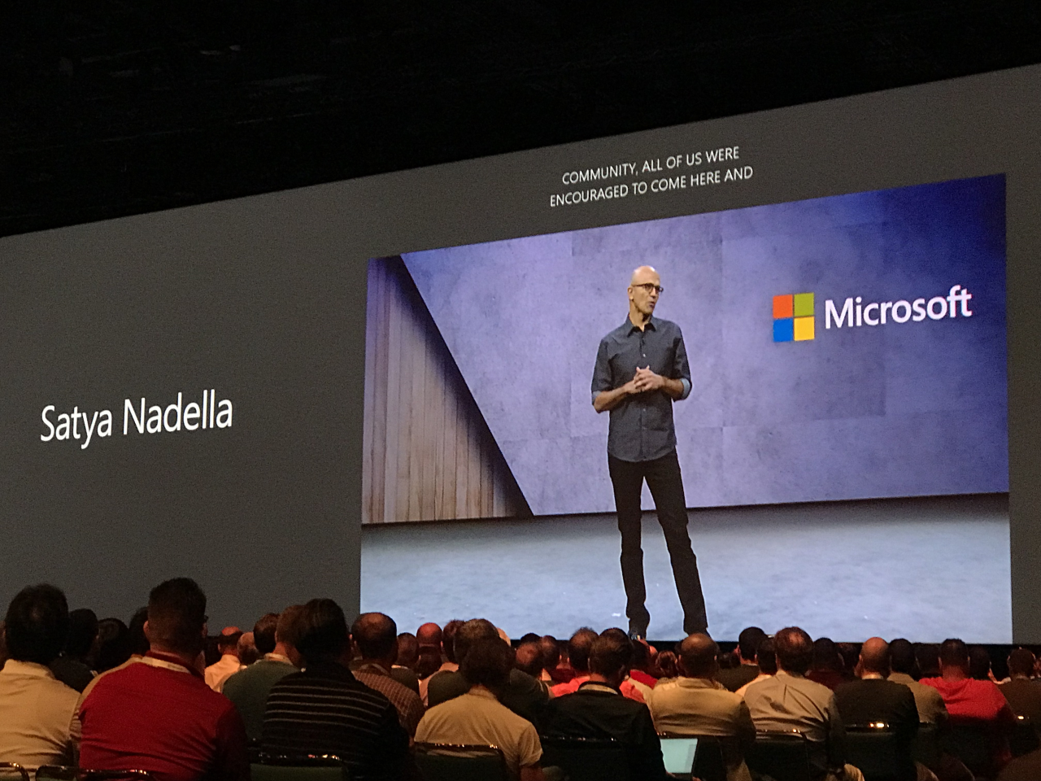
Office 365 and Microsoft 365

Slide 6

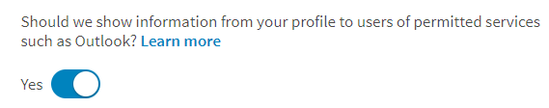
Linkedin profile data flows to Office 365
Rolling out for First Release customers in October
Linkedin profile data will surface in Microsoft services – Office 365 and Outlook.com initially
Users can opt-out through Linkedin privacy settings
User always controls whether or not profile data is accessible to external services such as Office 365
Will also provide ability to send Linkedin connection invites through Office 365
Uses Machine Learning to match existing contacts with Linkedin contacts
Announcement on changes
https://blog.linkedin.com/2017/september/250/adding-linkedin_s-profile-card-on-office-365-offers-a-simple-way

Slide 7

Microsoft Teams – intelligent communications
Microsoft Teams gains capabilities from Skype for Business
Teams is in the forefront to receive new features in the future
Teams client is the primary client for intelligent communications
Replaces Skype for Business client over time
Teams gets calling features, including audio conferencing which is now in preview
Skype for Business 2019 is being released H2/2018
Will get Teams coexistence capabilities
Admins can choose between SfB, Teams or both
No deadline communicated yet when customers have to switch to Teams
Intelligent Communications
http://skypeandteams.fasttrack.microsoft.com/
Prepare for Teams
https://docs.microsoft.com/en-us/MicrosoftTeams/prepare-teams
Notes:
Teams roadmap: https://products.office.com/en-us/business/office-365-roadmap?filters=microsoft%20teams#apply-filter

Slide 8

Multi-Geo in Office 365
In preview for SharePoint Online, Exchange Online and OneDrive for Business
Expand Office 365 presence to multiple regions in one tenant
Contact Microsoft to sign up for preview
Target date for availability is H1/2018
Once configured, you need to add satellite locations (e.g. EMEA or Australia) and configure user account to desired locations
Search returns results from all locations
Implication that this will be an add-on service, thus requiring a separate (paid) license
Multi-Geo: OneDrive for Business & SharePoint Online
https://technet.microsoft.com/library/094e86f2-9ff0-40ac-af31-28fcaba00c1d
Developer guidance
https://msdn.microsoft.com/en-us/pnp_articles/multigeo-introduction

Slide 9
Intelligent, personalized search
Personalization through Microsoft Graph
Search experience within SharePoint (and Office 365 in general) is redesigned
Search is more personalized, based on Microsoft Graph which gets insights for people, sites and documents (the signals)
Both the new experience and personalized features are available later this year
Search also works from Windows, and returns results from Office 365
Screenshots and announcement
https://techcommunity.microsoft.com/t5/Intelligent-Search-Discovery/Find-what-you-want-discover-what-you-need-with-personalized/ba-p/109590

Slide 10

Bing for business
AI and Microsoft Graph driven search results with organizational context
When using Bing for business, users can get results from Office 365 with organizational context
Sign up for private preview: http://aka.ms/b4bprivatepreview
Requires Office 365 E1, E3, E5, F1, Bus. Essentials/Premium/Edu E5
Several new services as part of this, including enterprise bookmarks, people search, organizational chart and search from Office 365 Groups
Users use www.bing.com after admitted in the preview
Background and overview
https://blogs.bing.com/search/2017-09/finding-what-you-need-at-work-just-got-easier-with-bing-for-business

Slide 11

Outer loop with Yammer
Outer loop drives organizational change
New mobile-ready web part for integrating Yammer conversations in SharePoint
Available in October
Preview and editing SharePoint documents in Yammer will be enriched
SharePoint file storage & OneNote for Office 365 connected Yammer groups
Set presence and initiate voice/video calls from Yammer (with Skype for Business)
Yammer data can be stored regionally (outside US), currently ni preview – available H1/2018
New analytics and insights component coming later
Microsoft Graph reporting API soon available for custom analytics
Initiate voice and video calls from Yammer
https://support.office.com/en-us/article/Use-Skype-for-Business-from-within-Yammer-e221b8ae-9647-4b46-b79e-257c36b1a1f8
Yammer Desktop App
http://aka.ms/yammerdesktop
Microsoft Graph Yammer endpoints
https://developer.microsoft.com/en-us/graph/docs/api-reference/beta/api/reportroot_yammeractivity

Slide 12
Compliance Manager
Available in preview
Manage compliance from one place
Provides
Real-time risk assessment
Actionable insights
Simplified compliance views
Covers Office 365, Dynamics 365 and Microsoft Azure
Compliance for GDPR, NIST and ISO standards
Seems to be free for existing customers
Sign up for preview, which is coming in November: https://aka.ms/compliance-manager-preview
Screenshots and overview
https://techcommunity.microsoft.com/t5/Security-Privacy-and-Compliance/Manage-Your-Compliance-from-One-Place-Announcing-Compliance/ba-p/106493

Slide 13

New features for the modern workplace
These are mostly for SharePoint Online and OneDrive for Business
A more consistent way to share files in Office 365
Simpler sharing with email-based verification
Over 270 file formats supports in ODB, Windows 10 File Explorer (and Files On-Demand)
SharePoint Migration Tool for migrating on-premises files to Office 365
New web parts, including support for Forms and Planner, and a connector web part
New SharePoint Admin Center (early 2018)
SharePoint Migration Tool
https://techcommunity.microsoft.com/t5/SharePoint-Blog/Introducing-the-SharePoint-Migration-Tool-from-Microsoft/ba-p/109767
SharePoint Admin Center preview https://forms.office.com/Pages/ResponsePage.aspx?id=v4j5cvGGr0GRqy180BHbR3CCKNES_u9Bul1dZT-hbi5UNTFUODdKQVNFQUJMRzAxTVhUMUsyWFlOOC4u

Slide 14
New features for the modern workplace (cont’d)
These are mostly for SharePoint Online and OneDrive for Business
Several new web parts, including
Forms support
Group calendar
File viewer
Twitter embeds
Spacer and Divider
Updates to communications sites
Page animation! ☺
Notifications for news articles through the SharePoint mobile app
All these changes are rolling out to First Release in late 2017
Detailed list of all smaller updates
https://techcommunity.microsoft.com/t5/SharePoint-Blog/Refine-your-message-and-increase-your-reach-with-SharePoint/ba-p/109553

Slide 15
New features for the modern workplace (cont’d)
These are mostly for SharePoint Online and OneDrive for Business
Word 2016 gets document metadata editing
Similar to ”Document Information Panel” in the good old days
In preview for First Release for Word 2016 on Windows
Attention views in SharePoint document metadata (October 2017)
Predictive indexing for document libraries, each tenant can have more than 30 trillion documents
Available in Q4/2017
Document reviews with Flow’s ”Send for review”
Updated Enterprise Content Management guidance
http://aka.ms/odsp-cswp
Resource center
https://aka.ms/sharepoint-contentservices

Slide 16
New features for the modern workplace (cont’d)
These are mostly for SharePoint Online and OneDrive for Business
SharePoint hub sites
Group SharePoint sites in a cohesive way using hub sites
Associates team sites and communications sites in an organized way
Hub provides consistency across sites
Navigation, theme, logo
Aggregates news, site activities and search results
Available H1/2018 for First Release

Slide 17
New features for the modern workplace (cont’d)
These are mostly for SharePoint Online and OneDrive for Business
Connect existing SharePoint team site to a new Office 365 group
Site retains its URL, settings and permissions
This will roll out to First Release customers in H1/2018
Custom site themes and custom site designs for a consistent UX
This will roll out to First Release customers in late 2017
SharePoint 2019 and Office 2019 announced, will be available in H2/2018

Slide 18
Office 365 Groups Naming Policy
Available in preview
Allows admins to enforce consistent naming strategy for Office 365 Groups
Is applied to group names and aliases
Applies to all Groups workloads, including Teams, SPO, Exchange, Planner etc.
Can have
Prefix-Suffix naming policy: PREFIX_GroupName_SUFFIX style
Custom blocked words: Don’t allow specific words
Max string length is 53 characters for Prefix-Suffix
Configuration through Azure AD Preview PowerShell module
Install-Module AzureADPreview
Naming policy PowerShell guidance
https://support.office.com/en-us/article/Office-365-Groups-Naming-Policy-6ceca4d3-cad1-4532-9f0f-d469dfbbb552

Slide 19
Microsoft 365 Firstline Workers & Education
Available since September 25, 2017
Microsoft 365 F1 is a new offering, including licenses for
Office 365
Windows 10
Enterprise Mobility + Security (EM+S)
Office Online is included, as well as 2 GB mailbox, SharePoint, Yammer, Groups, Teams and other core productivity tools
Microsoft 365 Education is also a new license offering – same as above, but also includes Minecraft: Education Edition
Microsoft 365 Firstline Workers
https://www.microsoft.com/en-us/microsoft-365/enterprise/firstline
Announcement for Firstline Workers
https://blogs.office.com/en-us/2017/09/25/all-workers-welcome-with-microsoft-365/
Microsoft 365 Education
https://educationblog.microsoft.com/2017/09/microsoft-365-education-affordable-solution/

Slide 20

Excel becomes more intelligent
Several new features available, and some coming later
Custom functions, based on JavaScript
Sign up for preview: https://aka.ms/customfunctions
SSO-support for Office Add-ins
https://dev.office.com/docs/add-ins/develop/sso-in-office-add-ins
Excel JavaScript APIs 1.5 and 1.6 generally available
Excel API 1.7 preview
https://github.com/OfficeDev/office-js-docs/tree/ExcelJs_OpenSpec
Excel gets ability to call Microsoft Graph through Azure Functions with extensions
Microsoft Graph bindings for Azure Functions
https://blogs.msdn.microsoft.com/appserviceteam/2017/09/25/my-intern-project-microsoft-graph-bindings-for-azure-functions/
Additional info on bindings
https://docs.microsoft.com/en-us/azure/azure-functions/functions-bindings-microsoft-graph

Slide 21
Office 365 developer platform
SharePoint Framework is now production ready
SharePoint Framework Extensions general availability
Allows extension and customization of site pages and list visualizations
https://docs.microsoft.com/en-us/sharepoint/dev/spfx/extensions/overview-extensions
Office UI Fabric Adobe XD Toolkits is generally available
See https://developer.microsoft.com/en-us/fabric#/resources for details
Microsoft Graph People APIs are generally available
https://developer.microsoft.com/en-us/graph/docs/api-reference/v1.0/resources/social_overview

Slide 22
Office 365 developer platform (cont’d)
Several API updates and releases
Microsoft Graph
Outlook calendars & contacts is generally available
Several new Outlook APIs
SDKs updated
SharePoint List APIs generally available
SP/ODB File handlers 2.0 generally available
https://docs.microsoft.com/en-us/onedrive/developer/file-handlers/
Several new samples for Patterns and Practices
StaffHub APIs and Flow connectors
Sign up for preview by emailing staffhubinfo@microsoft.com
New code samples and SDKs
https://developer.microsoft.com/en-us/graph/code-samples-and-sdks
Patterns and Practices
https://aka.ms/pnpignite2017

Slide 23
Office 365 developer platform (cont’d)
And several updates to simplify deployment
Centralized deployment of Office add-ins using Office 365 Admin Center or PowerShell
Can target groups of users, or tenant-wide
Teams gets new tenant admin controls for managing 3rd party apps
Enable select external apps by default
Allow/block apps
Allow Side-loading of external apps
AppSource is now the single web-based marketplace for Office Add-ins
Store.office.com is no more
Publishing through ISV Seller Dashboard: https://sellerdashboard.microsoft.com/Registration
App-only token support for OneDrive
https://docs.microsoft.com/en-us/onedrive/developer/
Centralized deployment
https://support.office.com/en-us/article/Deploy-Office-add-ins-in-the-Office-365-admin-center-737e8c86-be63-44d7-bf02-492fa7cd9c3f?ui=en-US&rs=en-US&ad=US
New Teams admin controls
https://techcommunity.microsoft.com/t5/Microsoft-Teams-Blog/New-admin-controls-for-apps-in-Teams/ba-p/78975

Slide 24
Get all Ignite 2017 recap presentations
http://bit.ly/Ignite2017Recap

